Slide 1
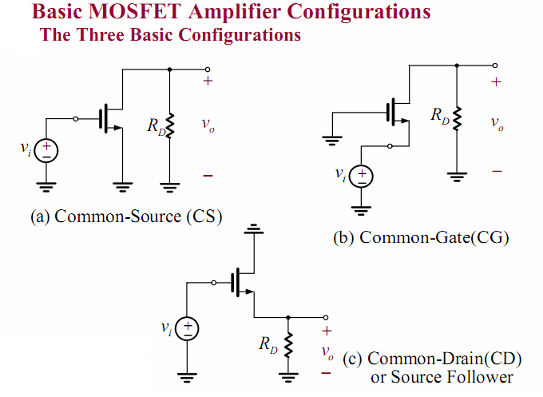


Slide 2
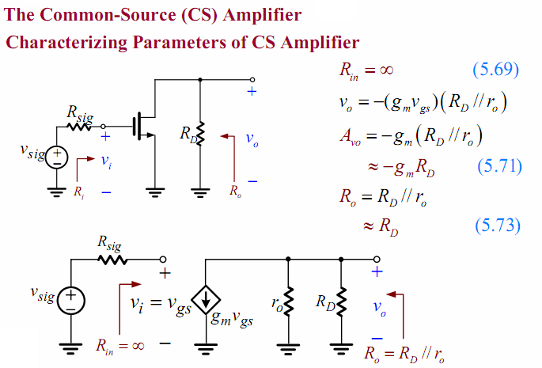

Slide 3
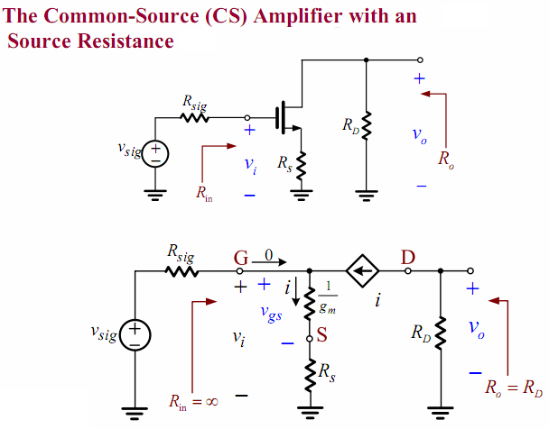

Slide 4
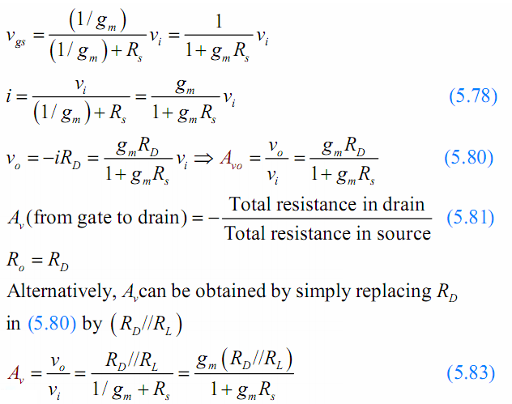

Slide 5
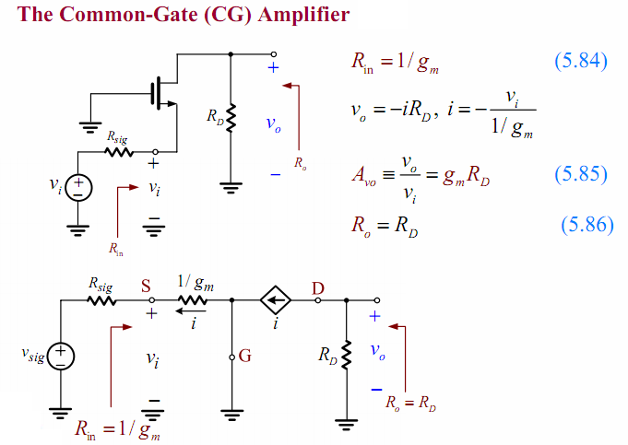

Slide 6
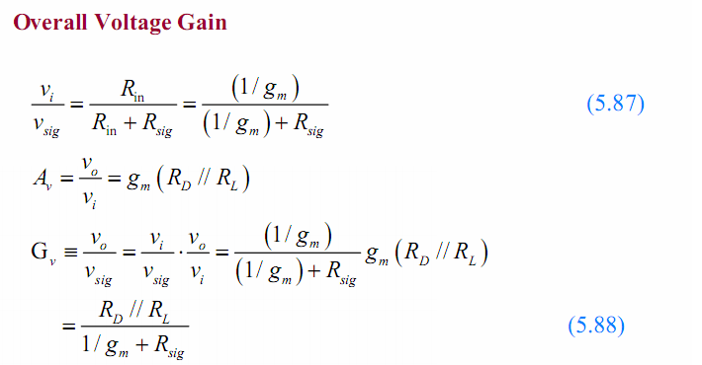

Slide 7
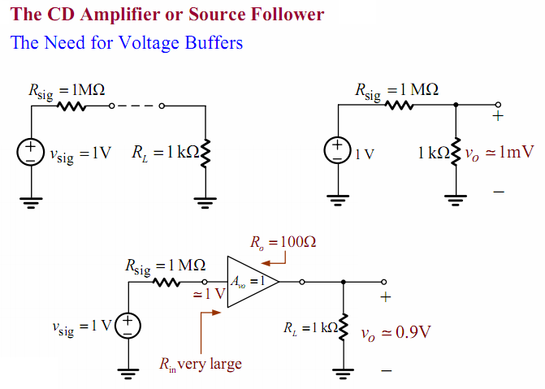

Slide 8
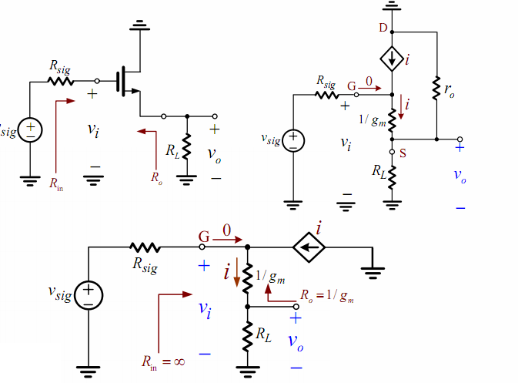

Slide 9
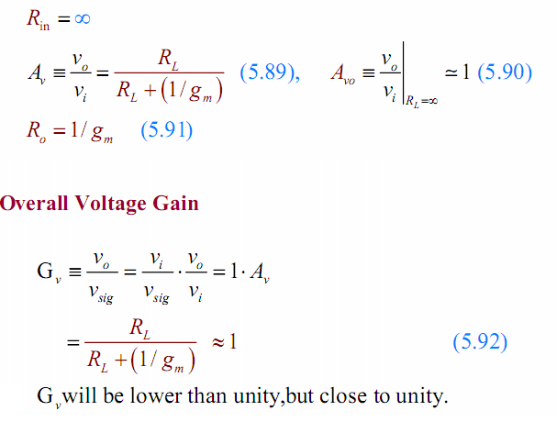

Slide 10
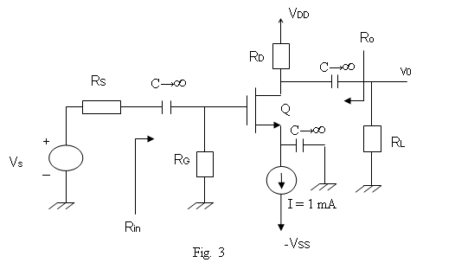
Question 3
V_{DD} = 12 V, R_{G} = 500 KΩ, R_{D} = 4 KΩ, R_{S} = 20 KΩ, R_{L} = 1 KΩ, V_{t} = 1V, and . (Neglect ro)
a. Compute V_{GS} and V_{DS}.
b. Plot the AC small-signal equivalent circuit.
c. What are the input and output impedances R_{in} and R_{o}. (5 Marks)
d. Find the voltage gain A_{v} = v_{o}/v_{s}.
You submit your solution not later than March 13, 2020.
You can send your solution with any format to Mr. Huy through his email nbdhuy@hcmiu.edu.vn

